Slide 1
EU-ESPS Task 3 - End Entity Revocation: Status Update
Virendra Kumar (Qualcomm)

Slide 2
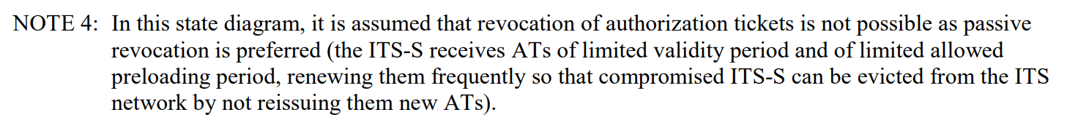
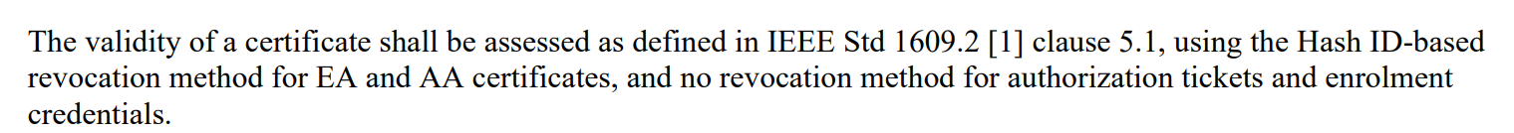
Overview
Currently, the European design (ETSI TS 102 940, 102 941, 103 097) has a major design flaw/weakness
  No mechanism to actively revoke a misbehaving/malfunctioning end entity
EU-ESPS Task 3 aims to address this gap
  Technical specification to allow for an efficient mechanism for device-level revocation as defined in IEEE 1609.2, while highlighting advantages, besides efficiency gains.
ETSI TS 102 941:
ETSI TS 103 097:

Slide 3
Current status
Task lead: Virendra Kumar (Qualcomm)
Task supporter(s): Aldi Caushi (Ford), ??
Requires three new work items and change requests at ETSI ITS WG5 to update ETSI TS 102 940, 102 941, 103 097
Overview presentation at ETSI scheduled for June 15th
Work items to be introduced at the next ETSI virtual F2F end of June
  Need 5 supporting ETSI members to introduce a new work item
(Overly optimistic) estimated completion end of 2022 Q1

